Slide 1
CST305 SYSTEM SOFTWARE
Notes:
1
1

Slide 2
COURSE OUTCOME
The Students will be able to
CO1 : Distinguish softwares into system and application software categories.
(Cognitive Knowledge Level: Understand)
CO2 : Identify standard and extended architectural features of machines.
(Cognitive Knowledge Level: Apply)
Notes:
2
2

Slide 3
Text book
1. Leland L. Beck, System Software: An Introduction to Systems Programming, 3/E, Pearson Education Asia
Notes:
3

Slide 4
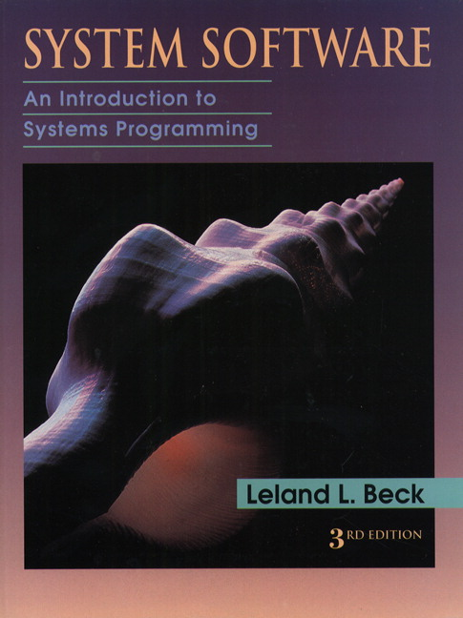
Notes:
4
4

Slide 5
Module-1 ( Introduction)
System Software vs Application Software, Different SystemSoftware– Assembler, Linker, Loader, Macro Processor, Text Editor, Debugger, Device Driver, Compiler, Interpreter,Operating System (Basic Concepts only). SIC & SIC/XE Architecture, Addressing modes, SIC & SIC/XE Instruction set , Assembler Directives.
Notes:
5
5

Slide 6
Software can be divided into two categories:
System Software
Application Software
Notes:
6

Slide 7
System Software
Consists of variety of programs that support the operation of a computer.
Set of programs that coordinates activities and functions of the hardware and various other programs.
A system software programmer must know the target machine structure.
Eg:- Operating System, Compiler, Debugger etc.
Notes:
7
7

Slide 8
Application Software
Programs that help users solve particular computing problems.
Application software usually used by end-user.
It is concerned with the solution of some problem, using the computer as a tool, instead of knowing how computers actually work.
Eg:- Library automation software
Notes:
8

Slide 9
System software manages and operates computer hardware thereby providing platform for other application software.
System software makes it possible for the users to focus on an application or other problem to be solved, without needing to know the details of how the machine works internally.
One characteristic in which most system software differs from application software is machine dependency.
System software can run independently of the application software while application software cannot run without the presence of the system software.
Notes:
9
9

Slide 10
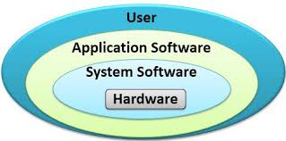
Notes:
10
10

Slide 11
System Software Concept
Users
Application Program
Debugger
Macro Processor
Text Editor
Utility Program (Library)
Complier
Assembler
Load and Linker
OS
Memory Management
Process Management
Device Management
Information Management
Bare Machine (Computer)
11
Notes:
11
11

Slide 12
Features of System Software / Application Software
Machine independent
Machine Dependent
Computer
Notes:
12
12

Slide 13
Different System Softwares
Assembler
Loader
Linker
Macro Processor
Text Editor
Debugger
Device Driver
Compiler
Interpreter
Operating System
Notes:
13
13

Slide 14
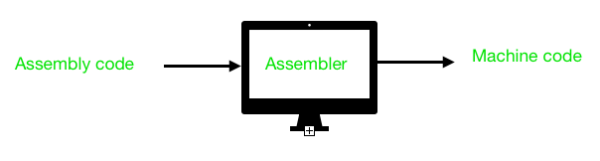
Assembler
translate assembly language to machine language.
Fundamental functions:
1. Translating mnemonic operation codes to their machine language equivalents.
2. Assigning machine addresses to symbolic tables used by the programmers.
Notes:
14
14

Slide 15
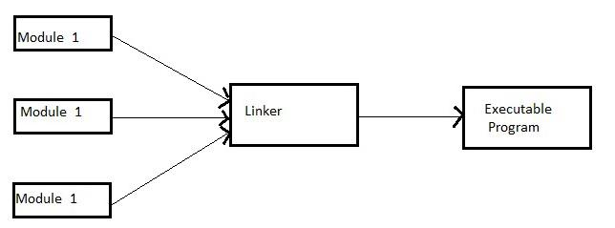
Loader
loads the object program into memory for execution.
Linker
Combines two or more separate object programs and supplies the information needed to allow references between them .
Notes:
15

Slide 16

Compiler
translate high level language to machine language.
Interpreter
translates a statement of high-level language to machine language and executes it immediately. The program instructions are taken line by line (without previously compiling them into a machine language).
Notes:
16

Slide 17
Text Editor
To create and modify the program
Debugger
To help detect errors in the program
Device driver
operates or controls a particular type of device that is attached to your computer.
hide completely the details of how the device works from the user.
Notes:
17
17

Slide 18
Macro Processor
macro represents a commonly used group of statements in the source programming language.
The macro instruction is replaced by the macro processor with the corresponding group of source language statements. This operation is called “expanding the macro”
Operating System
manages computer hardware and software resources and provides services for computer programs.
The functions of OS are:
Process management
Memory management
Resource management
I/O operations
Data management
Providing security to user’s job.
Notes:
18

Slide 19
The Simplified Instructional Computer (SIC)
SIC comes in two versions
The standard model
An XE version
“extra equipments”, “extra expensive”
SIC (Simplified Instructional Computer)
SIC/XE (Extra Equipment)
The two versions has been designed to be upward compatible.
19
Notes:
19
19
19

Slide 20
The Simplified Instructional Computer
SIC
Upward compatible
There are a total of 32768 bytes (32 KB) in the computer memory.
Memory consists of 8-bit bytes, 3 consecutive bytes form a word (24 bits)
5 registers, 24 bits in length
A 0 Accumulator
X 1 Index register
L 2 Linkage register (JSUB)
PC 8 Program counter
SW 9 Status word (Condition Code)
20
Notes:
20
20

Slide 21
SIC Machine Architecture
Data Formats
Integers are stored as 24-bit binary number.
2’s complement representation for negative values.
Characters are stored using 8-bit ASCII codes.
No floating-point hardware on the standard version of SIC.
21
Notes:
21
21

Slide 22
SIC Machine Architecture
Instruction format
24-bit format.
The flag bit x is used to indicate indexed-addressing mode.
8
1
15
opcode
x
address
22
Notes:
22
22

Slide 23
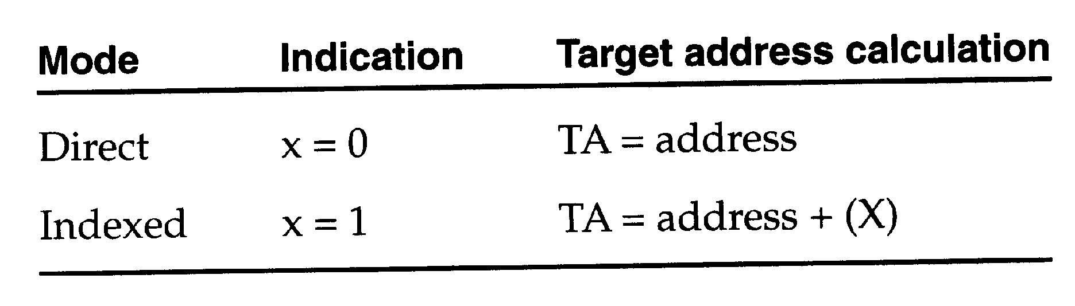
Addressing Modes
There are two addressing modes available
Indicated by x bit in the instruction
(X) represents the contents of reg. X
Notes:
23

Slide 24
Instruction set
Load and store instructions (LDA, LDX, STA, STX, etc.)
Integer arithmetic instructions (ADD, SUB, MUL, DIV)
Compare instruction (COMP)
Conditional jump instructions (JLT, JEQ, JGT)
Subroutine linkage instructions (JSUB jumps to the subroutine, placing the return address in register L. RSUB jumping to the address contained in register L.)
24
Notes:
24
24

Slide 25
I/O Instructions
Each device is assigned a unique 8-bit code as an operand.
Test Device (TD): tests whether the addressed device is ready to send or receive.
Condition code is set to indicate the result of this test.
Setting of ‘<’ indicates the device is ready to send or receive.
Setting of ‘= ‘ indicates the device is not ready
Read Data (RD)
Write Data (WD)
I/O are performed by transferring 1 byte at a time to or from the rightmost 8 bits of register A.
25
Notes:
25
25

Slide 26
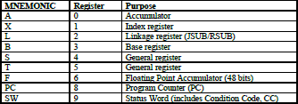
SIC/XE Machine Architecture
1 megabytes (1024 KB) in memory
3 additional registers, 24 bits in length
26
Notes:
26
26

Slide 27
Data format
24-bit binary number for integer, 2’s complement for negative values
Characters are stored in 8-bit ASCII format
48-bit floating-point data type
The absolute value of floating point number is
f*2^{(e-1024)}
Exponent is an unsigned binary number between 0 and 2047.
1
11
36
S
exponent(e)
Fraction(f)
27
Notes:
27
27

Slide 28
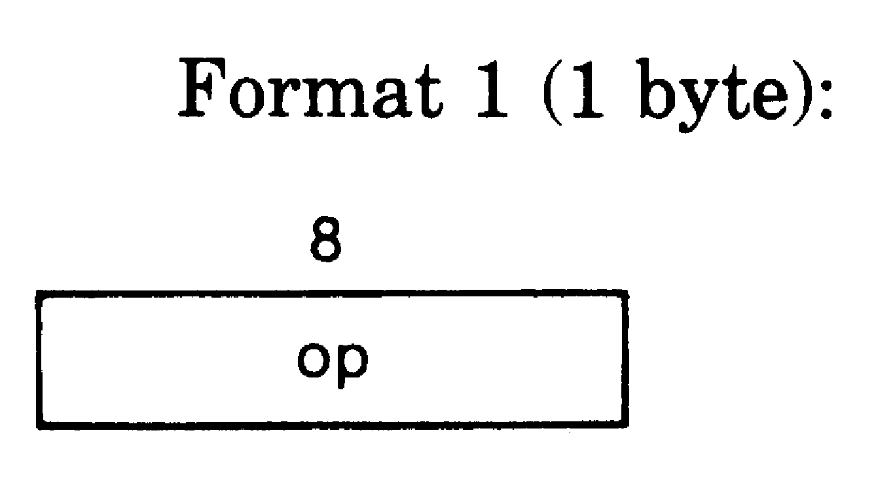
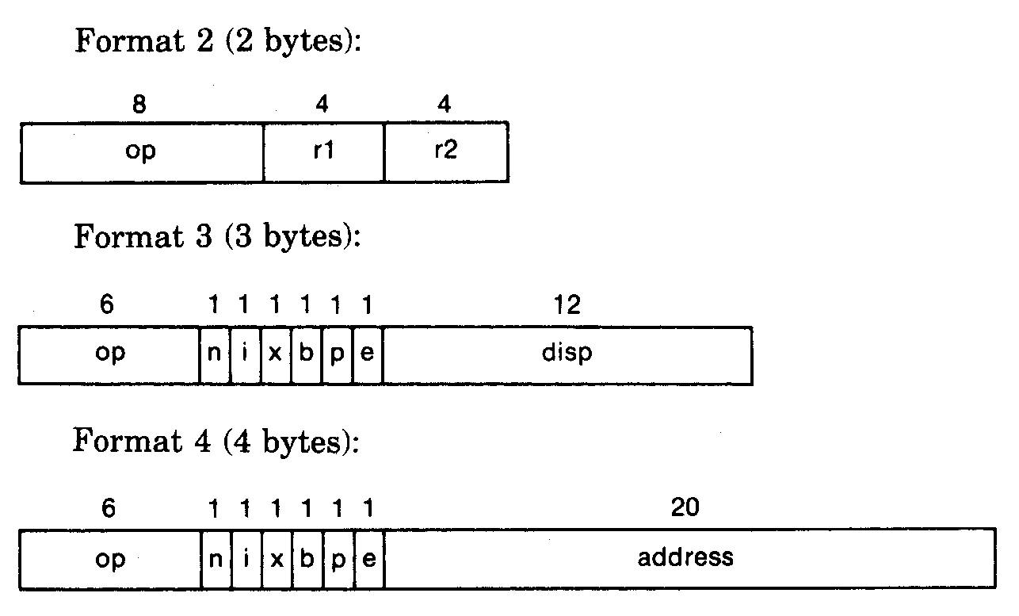
Instruction formats
28
Notes:
28
28

Slide 29
n --- indirect addressing mode
i --- immediate addressing mode
x --- index addressing mode
b --- base relative addressing mode
p --- program counter relative addressing mode
e --- extended format, format 4
Notes:
29

Slide 30
Addressing modes
Immediate n=0, i=1
Indirect n=1, i=0
Direct b=0, p=0
Index x=1
Base relative b=1, p=0
PC relative b=0, p=1
simple addressing n=1, i=1 (for SIC: n=0 , i=0)
TA = location of the operand.
30
Notes:
30
30

Slide 31
PC relative
TA=(PC)+disp
-2048 <= disp <= 2047
Base relative
TA=(B)+disp
0 <= disp <= 4095
Notes:
31

Slide 32
Index+Base relative x=1, b=1, p=0 TA=(B)+disp+(X)
Index+PC relative x=1, b=0, p=1
TA=(PC)+disp+(X)
Index+Direct x=1, b=0, p=0
TA=disp+(X)
Format 4 e=1
32
Notes:
32
32

Slide 33
Format 1 (1 byte):
Eg.- RSUB (Return to subroutine)
opcode : 4C 0100 1100
object code : 4C 0100 1100
Format 2 (2 bytes) :
Eg.- COMPR A, S (Compare the contents of two registers)
opcode : A0 1010 0000
object code : A004 1010 0000 0000 0100
Notes:
33

Slide 34
Format 3 (3 bytes) :
Eg.- LDA #3 (load 3 into accumulator A)
opcode for LDA is 00 (0000 0000)
n—0, i—1, x—0, b—0, p—0, e—0
object code : 010003 🡪 0000 0001 0000 0000 0000 0011
Format 4 (4bytes) :
Eg. +JSUB RDREC (jump to the subroutine RDREC , suppose which is stored in address 1036)
opcode for JSUB is 48 ( 0100 1000)
n—1,i—1,x—0, b—0, p—0, e—1
object code :
4B101036 🡪 0100 1011 0001 0000 0001 0000 0011 0110
Notes:
34

Slide 35
Base relative (Format 3)
Eg. STL RETADR (let, EA of RETADR is 0036 & [B]=0006 )
Opcode of STL is 14 (0001 0100)
disp. = TA – [B]
= 0036 – 0006
= 0030
n—1, i—1, x—0, b—1, p—0, e—0
object code : 174030 🡪 0001 0111 0100 0000 0011 0000
Notes:
35

Slide 36
PC relative (Format 3)
Eg. 0000 STL RETADR (let, EA of RETADR is 0030)
Opcode of STL is 14 (0001 0100)
[PC]=0003
disp. = TA – [PC]
= 0030 – 0003
= 002D
n—1, i—1, x—0, b—0, p—1, e—0
object code : 17202D 🡪 0001 0111 0010 0000 0010 1101

Slide 37
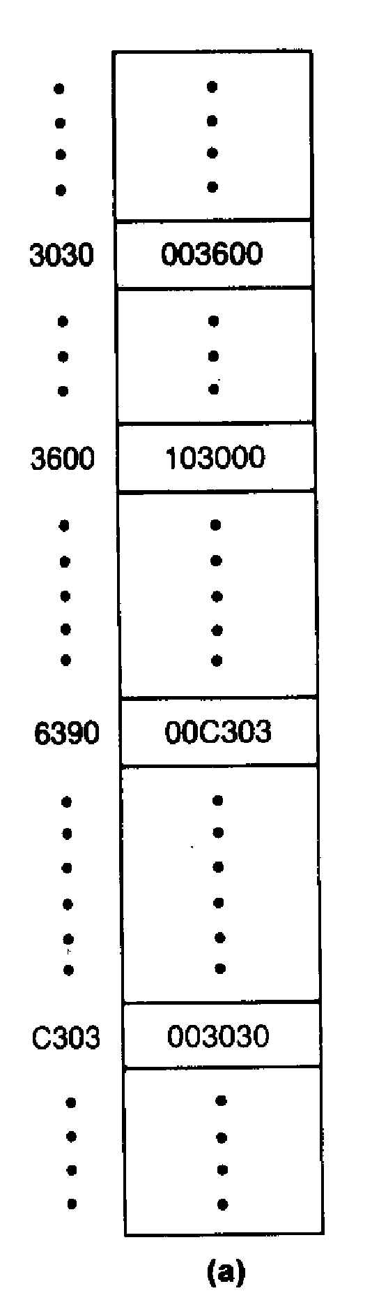
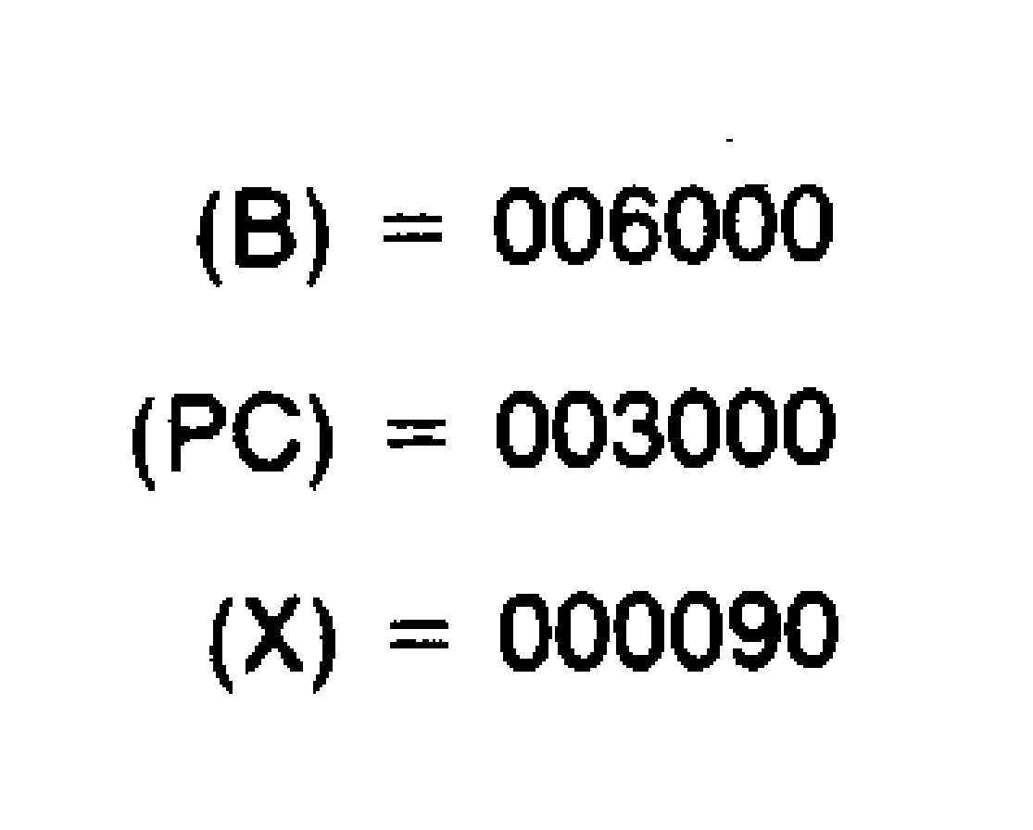
Questions:
Which instruction / Addressing mode?
What is the Target Address (TA)?
What value is loaded in to A?
37
Notes:
37
37

Slide 38
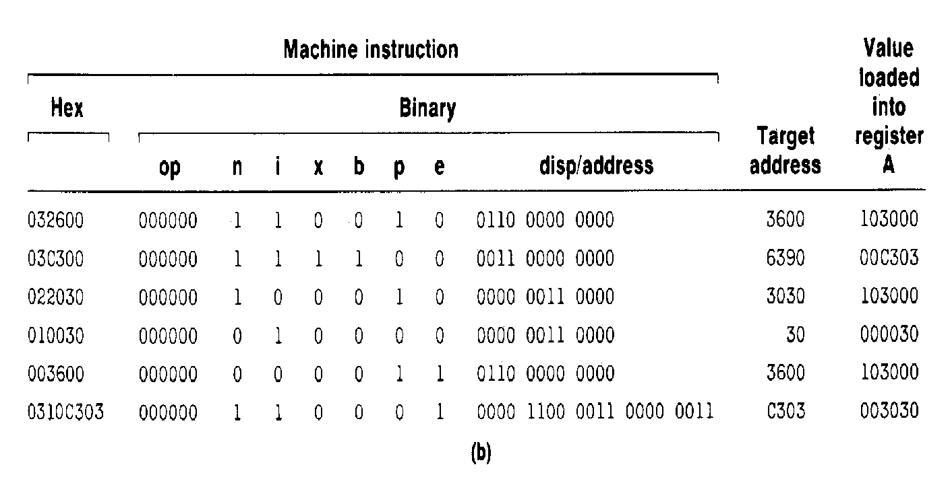
38
Notes:
38
38

Slide 39
Instruction set
Load and store instructions (LDB, STB, etc.)
Floating-point arithmetic instructions (ADDF, SUBF, MULF, DIVF)
Register-to-register arithmetic instructions (ADDR, SUBR, MULR, DIVR)
A special supervisor call instruction (SVC) is provided
I/O
1 byte at a time, TD, RD, and WD
SIO, TIO, and HIO are used to start, test, and halt the operation of I/O channels.
39
Notes:
39
39

Slide 40
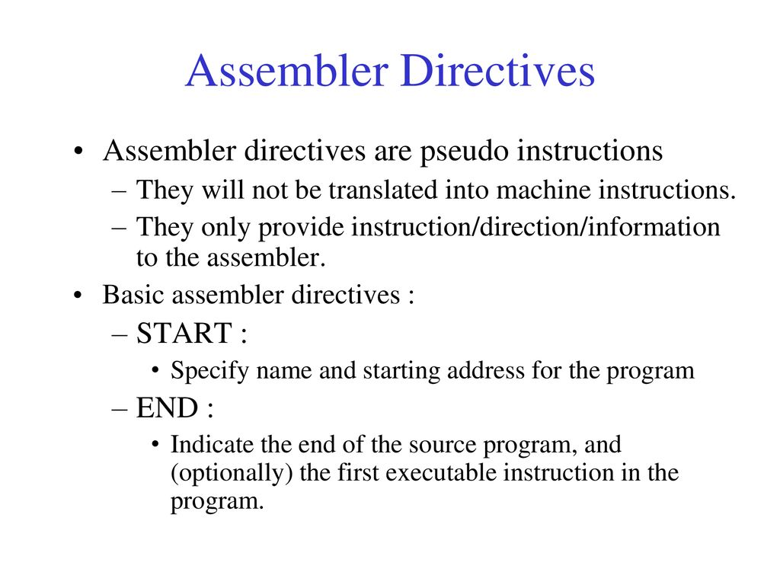
40
Notes:
40
40

Slide 41
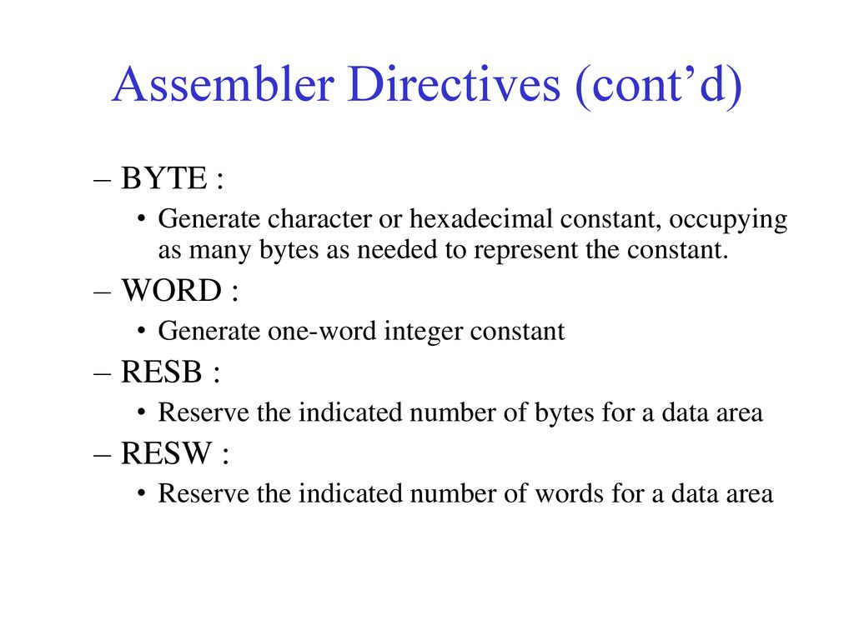

Slide 42
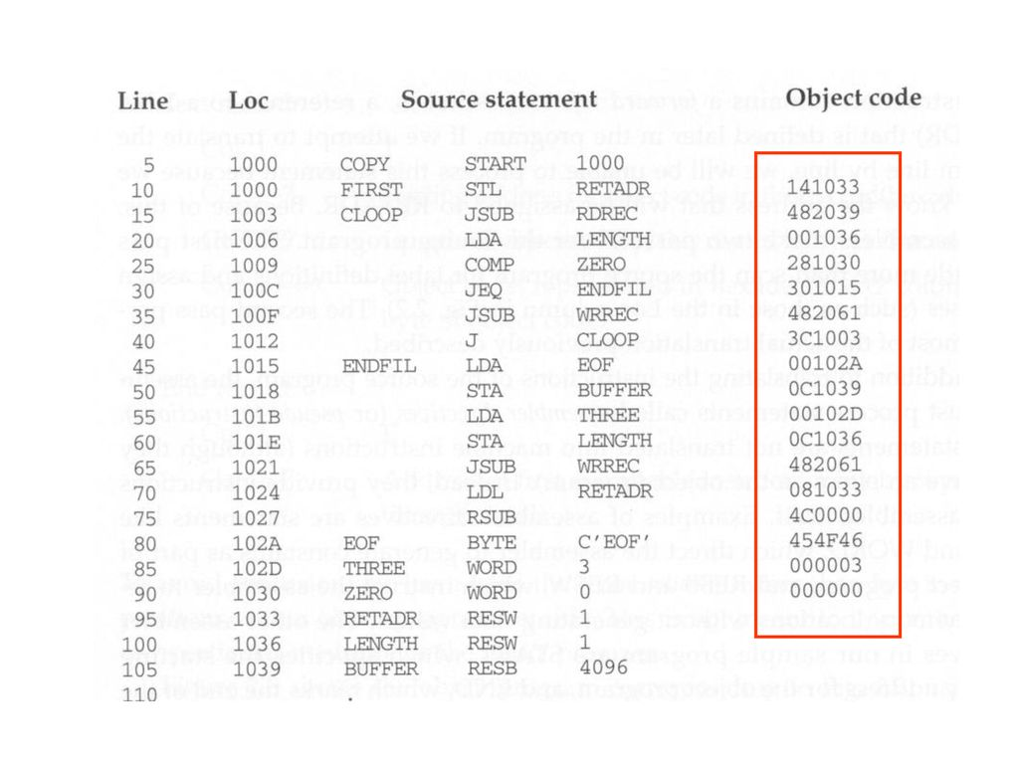

Slide 43
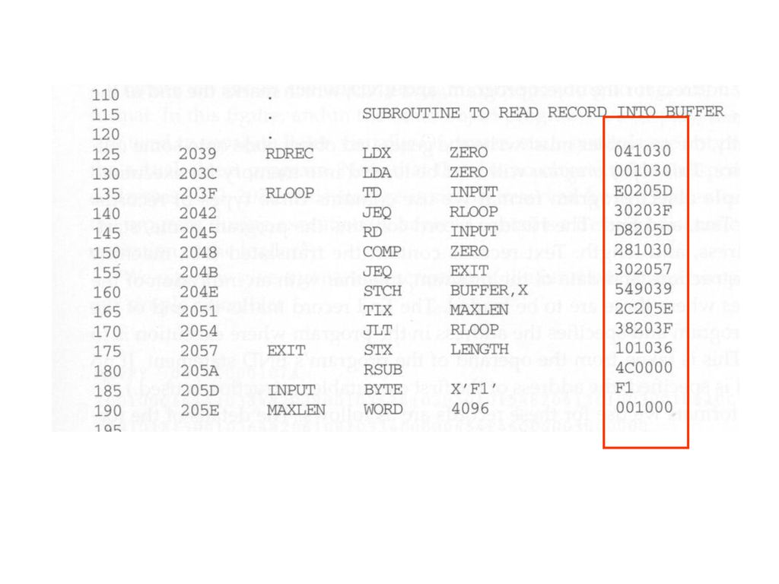

Slide 44
